Slide 1
From Raw Data to Actionable Intelligence A Case Study on the Pool Code Mapping Dashboard
Hover on Me
Presented By: Padmanava Das
Student-Id: CT_CSI_PB_4325

Slide 2

Watch Project Video

Slide 3
Business objective
The Goal: To eliminate ambiguity and gain complete, on-demand visibility into the status of our customer portfolios (Pool Codes).
The Vision: To empower management with a data intelligence tool to effectively track revenue sources, resource allocation, and compliance across all dimensions.

Slide 4
Problem statement / Project scope
Lack of a centralized system to track the assignment of Relationship Managers (RMs) to Pool Codes, leading to potential revenue loss, service gaps, and compliance risks.
Identify, clean, and model the provided Pool Code data.
Create a comprehensive Power BI dashboard to measure key KPIs like mapping status and product allocation.
Incorporate filters to allow for dynamic data slicing.
The dashboard must provide both high-level summaries and granular, detailed views.

Slide 5
Solution approach
Data Source: A single CSV file containing all Pool Code information.
Tool of Choice: Microsoft Power BI (Desktop Version)
Data Source: A single excel file containing all Pool Code information.
Ingested the raw data and performed intensive cleaning, restructuring, and enrichment.
Developed an interactive dashboard with DAX measures to calculate and display our KPIs.

Slide 6
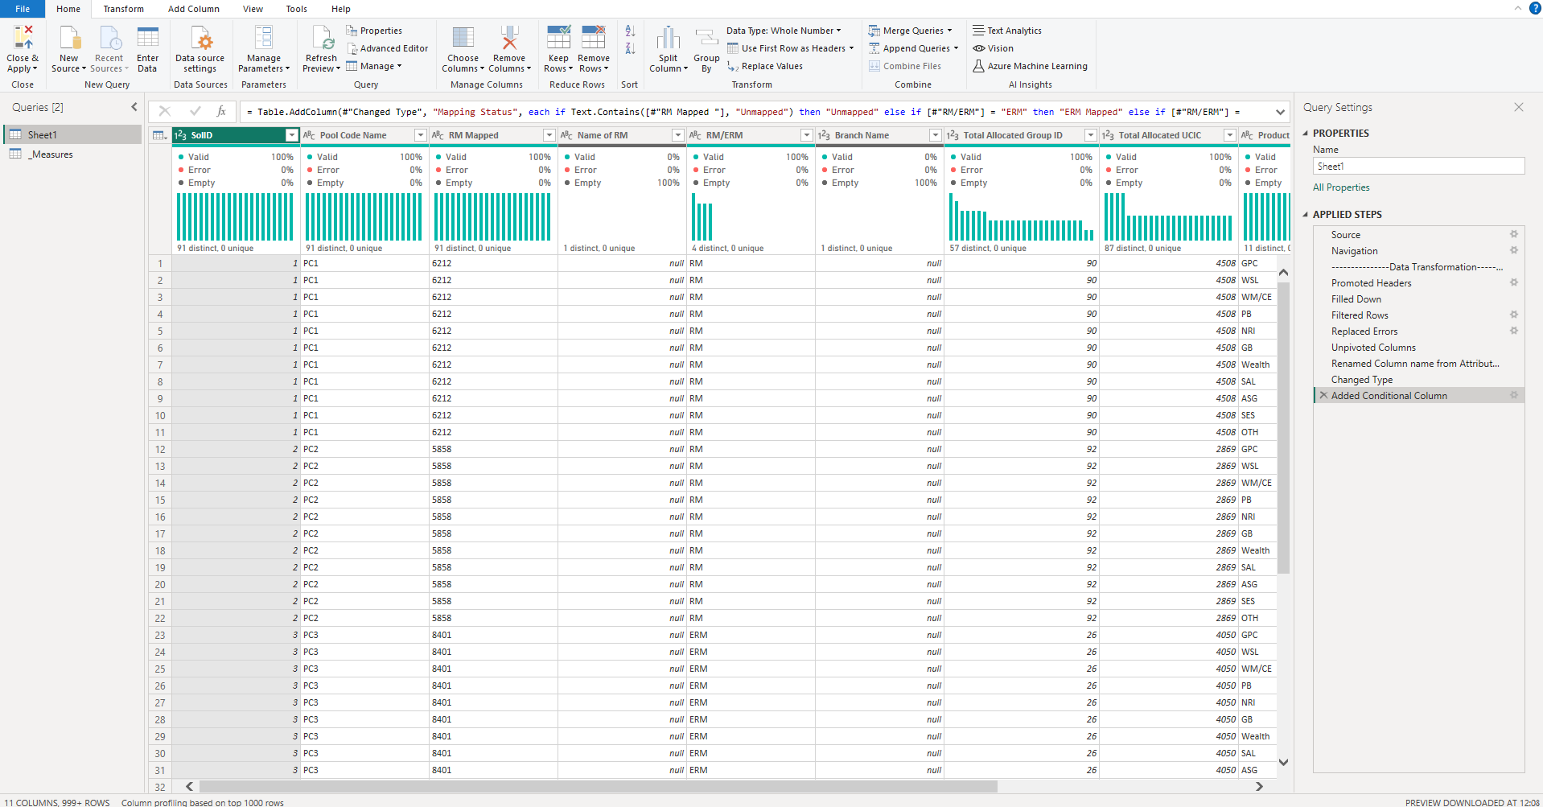
Data cleaning/transformation in Power Query

Slide 7
Data cleaning/transformation in Power Query
Key Transformations Performed:
Corrected Structural Errors: Merged records that were incorrectly split across two rows using the Fill Down technique.
Replaced Errors: Systematically found and replaced all data errors in the product columns with '0' to ensure data integrity.
Unpivoted Data: Transformed over 20 'wide' product columns into a 'long' format with two columns ('Product' and 'Allocated Value'), making the data suitable for analysis.
Created Conditional Column: Added a 'Mapping Status' column based on business rules to categorize each Pool Code.

Slide 8
Data cleaning/transformation in Power Query
Why Measures? DAX measures are reusable formulas that ensure consistent and accurate calculations across the entire dashboard.
Key Measures Created:
Total Pool Codes: A distinct count of all unique pool codes.
Mapped Codes: Calculates the number of codes assigned to an RM or ERM.
Unmapped Codes: Calculates the number of codes with an "Unmapped" status.
ERM Mapped Codes: A specific count of codes mapped only to ERMs.

Slide 9
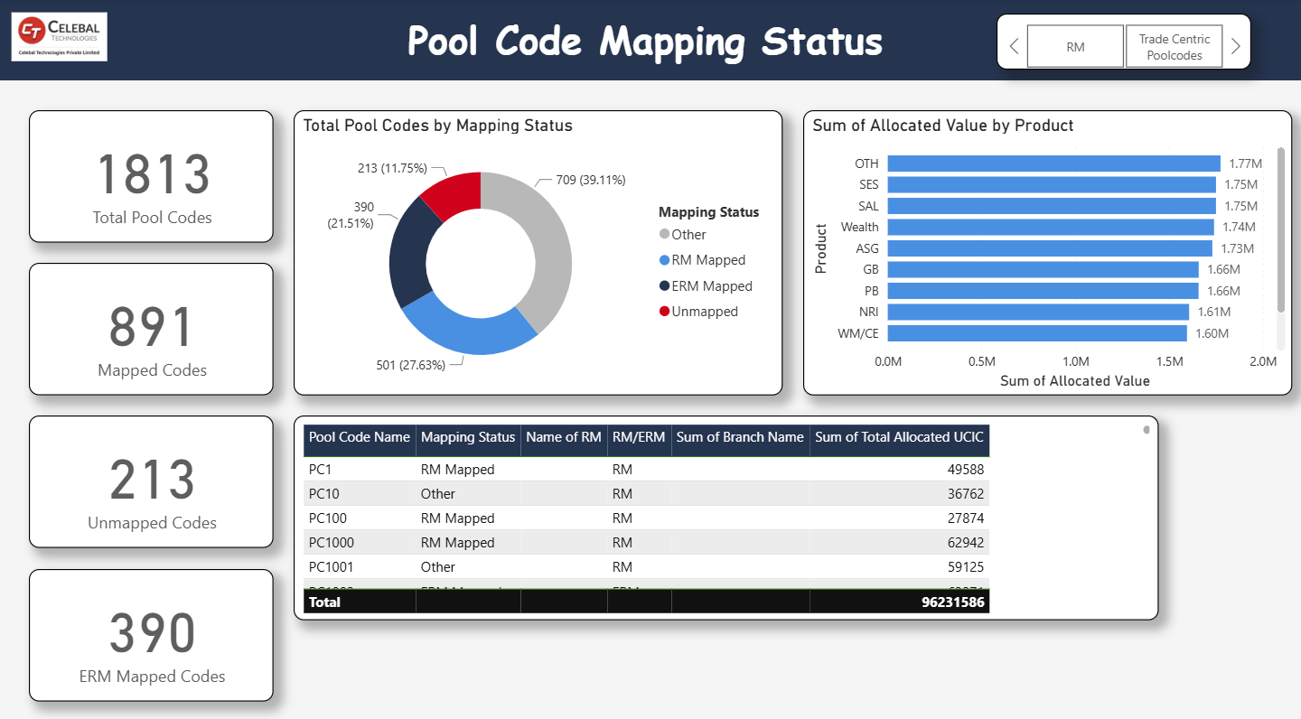
The Solution - The KPI Dashboard

Slide 10
Features of the dashboard
At-a-Glance KPIs: Four cards at the top display the most critical metrics for a high-level overview.
Visual Analysis:
A Donut Chart shows the percentage breakdown of Mapped vs. Unmapped codes.
A Bar Chart visualizes the total allocated value by product type.
Granular Detail: A Table Visual at the bottom allows users to see detailed information for every single pool code.
Interactive Filtering: A Slicer for RM/ERM status allows the user to filter the entire dashboard instantly.

Slide 11
Business outcomes
Insight 1: Quantified Risk
We have identified exactly 213 unassigned pool codes. This is our immediate priority list.
Insight 2: Strategic Allocation
We can now analyze the workload and portfolio distribution between RMs and ERMs to ensure it aligns with our business strategy.
Insight 3: Product Focus
The dashboard reveals the most significant products within these portfolios, providing data to guide sales strategy and training.

Slide 12
Conclusion
We have successfully transformed a complex dataset into a powerful, interactive dashboard that provides critical visibility and drives accountability.
This project proves that with the right approach and accessible tools like Power BI Desktop, we can create high-impact business intelligence solutions.

Slide 13
Thank you!

